Slide 1
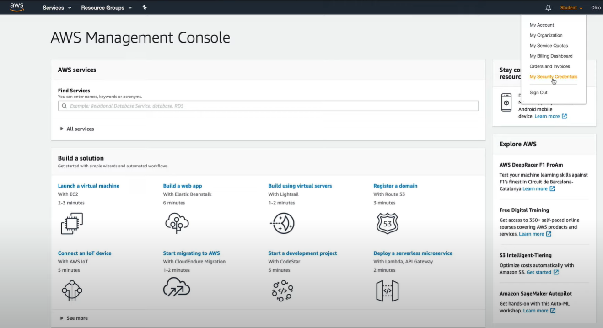
Securing Root User With MFA
Intro to Cloud Computing https://www.udacity.com/course/intro-to-cloud-computing--ud080

Slide 2
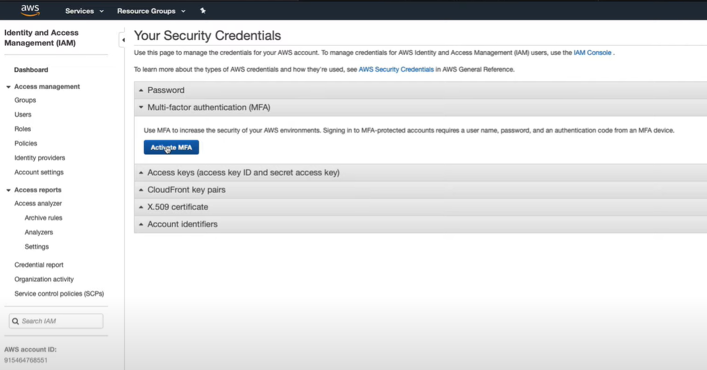
Securing Root User With MFA
Intro to Cloud Computing https://www.udacity.com/course/intro-to-cloud-computing--ud080

Slide 3
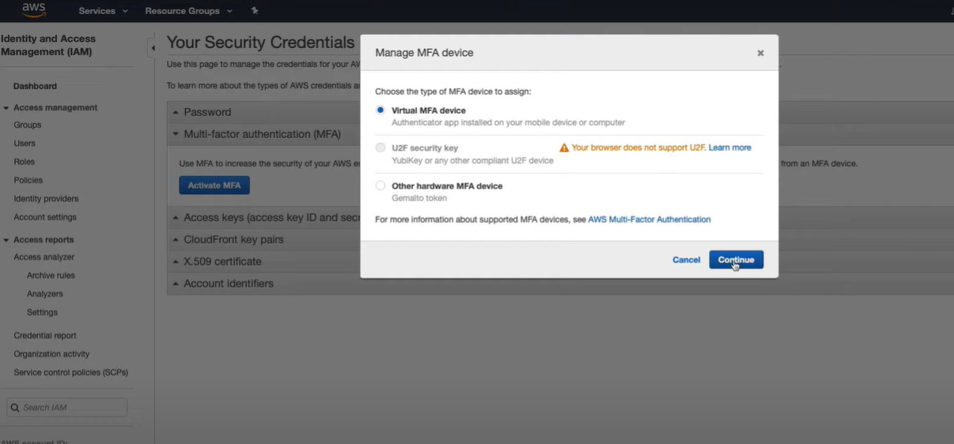
Securing Root User With MFA
Intro to Cloud Computing https://www.udacity.com/course/intro-to-cloud-computing--ud080

Slide 4
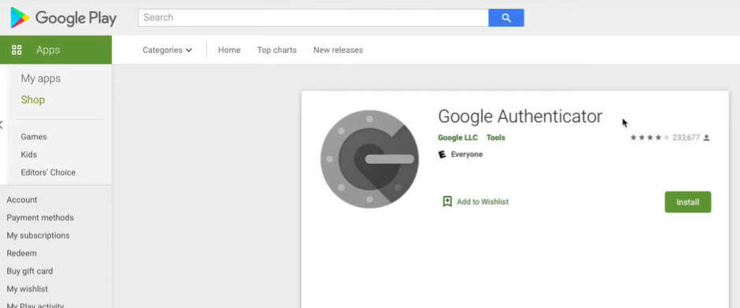
Securing Root User With MFA
Install Google Authenticator app.
Intro to Cloud Computing https://www.udacity.com/course/intro-to-cloud-computing--ud080

Slide 5
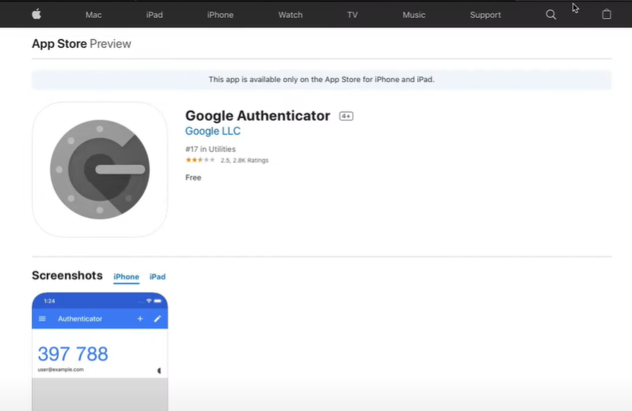
Securing Root User With MFA
Intro to Cloud Computing https://www.udacity.com/course/intro-to-cloud-computing--ud080

Slide 6
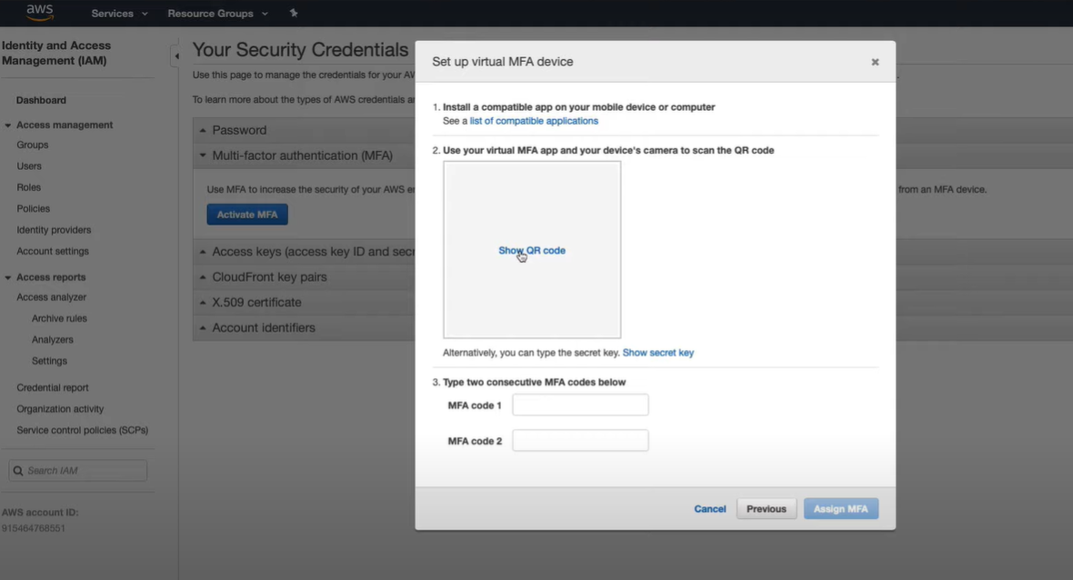
Securing Root User With MFA
Intro to Cloud Computing https://www.udacity.com/course/intro-to-cloud-computing--ud080

Slide 7
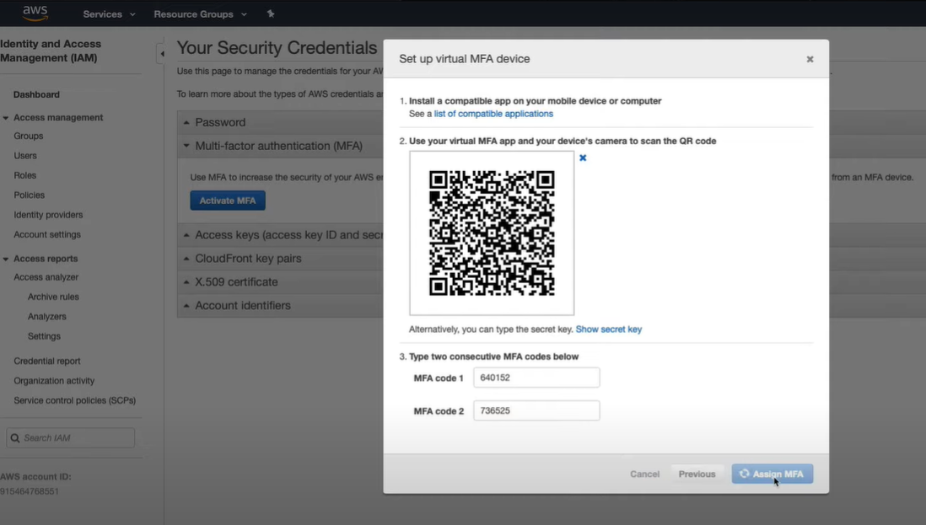
Securing Root User With MFA
Intro to Cloud Computing https://www.udacity.com/course/intro-to-cloud-computing--ud080

Slide 8
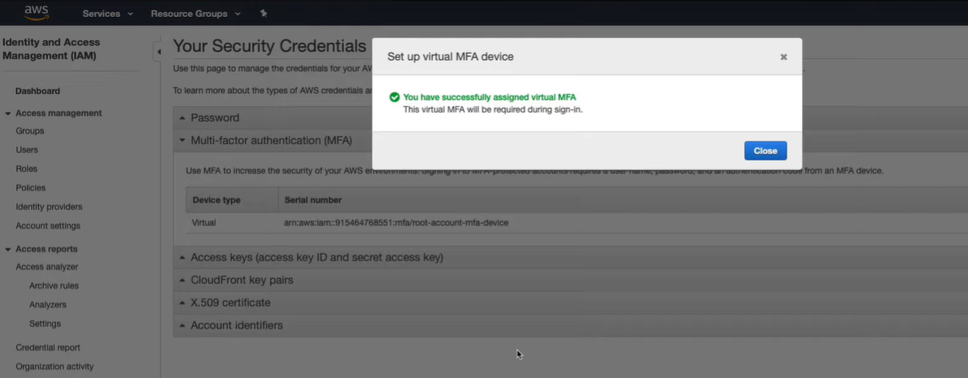
Securing Root User With MFA
Intro to Cloud Computing https://www.udacity.com/course/intro-to-cloud-computing--ud080

Slide 9
Exercise: Creating A Manager IAM User With Built-in Policies
In this exercise, you will create an IAM user for a manager, and apply built-in IAM policies.
Instructions
Create an IAM user
Name the user "manager"
Provide this user with:
  IAM Full Access permissions
  S3 Full Access permissions
  EC2 Full Access permissions
Intro to Cloud Computing https://www.udacity.com/course/intro-to-cloud-computing--ud080

Slide 10
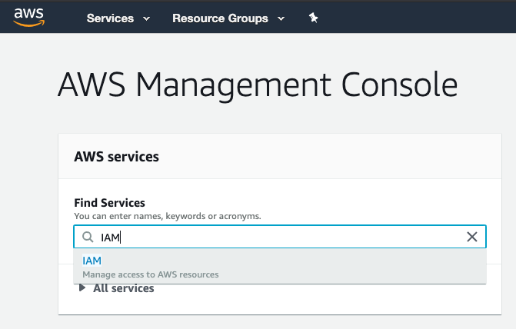
Exercise: Creating A Manager IAM User With Built-in Policies
Creating An IAM User
While logged in as the root account user, navigate to the IAM console.
Intro to Cloud Computing https://www.udacity.com/course/intro-to-cloud-computing--ud080

Slide 11
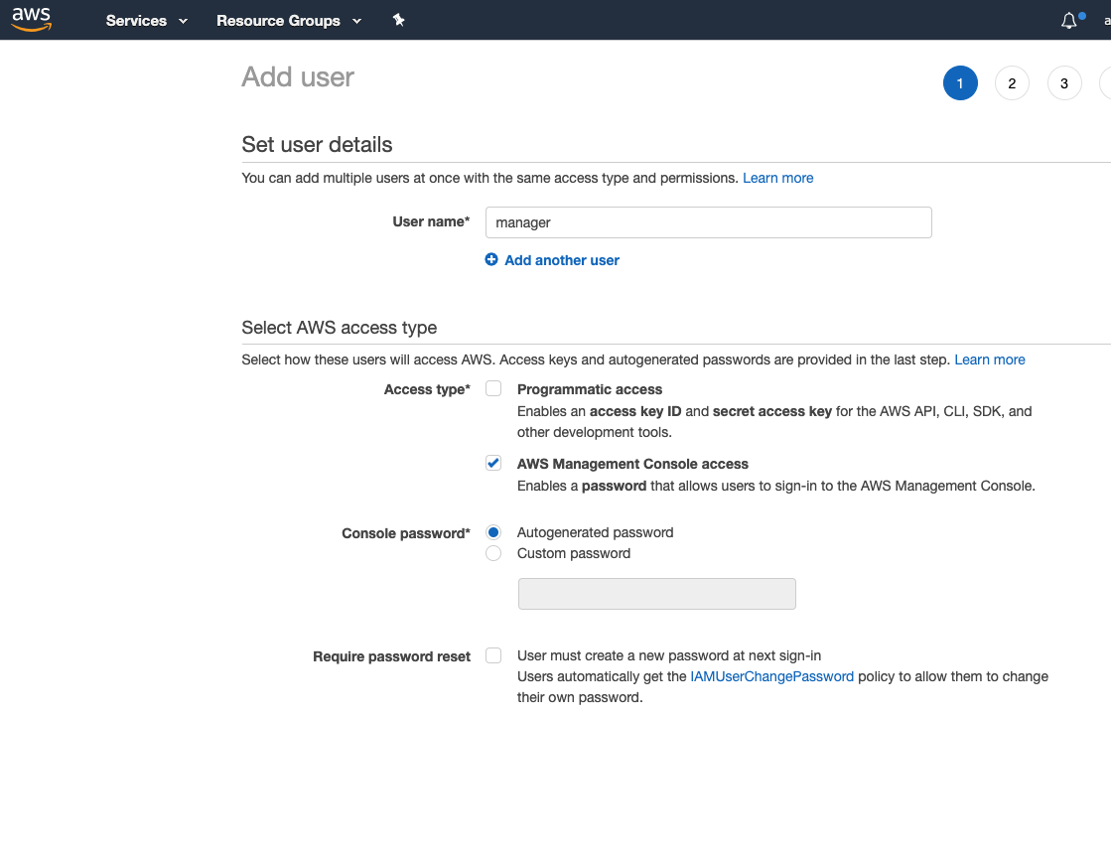
From the left sidebar click on Users to get into the Users page
Click the Add User button and set the User name to manager
Select the AWS Management Console Access access type
Leave the Autogenerated password on
Uncheck the option for Require password reset
Click on the Next: Permissions button

Slide 12
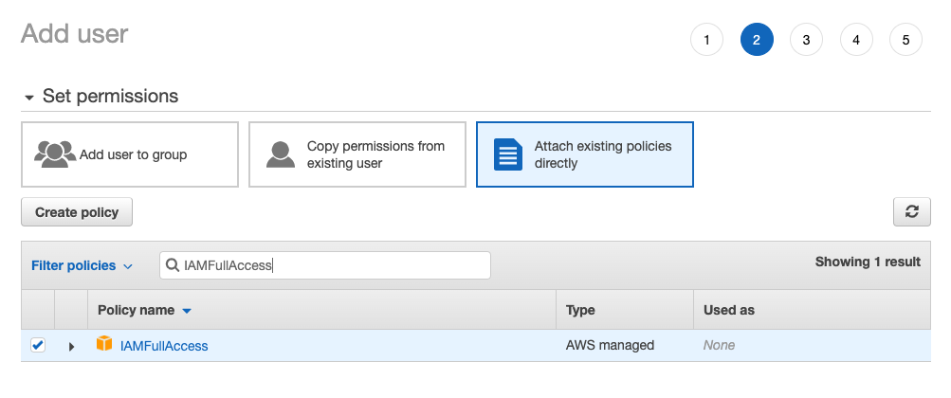
7. Click on the Attach existing policies directly button
8. Search for IAMFullAccess and select it

Slide 13
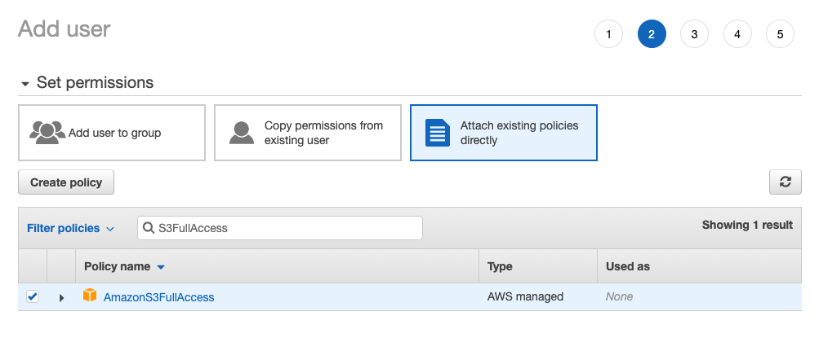
9. Search for S3FullAccess and select it

Slide 14
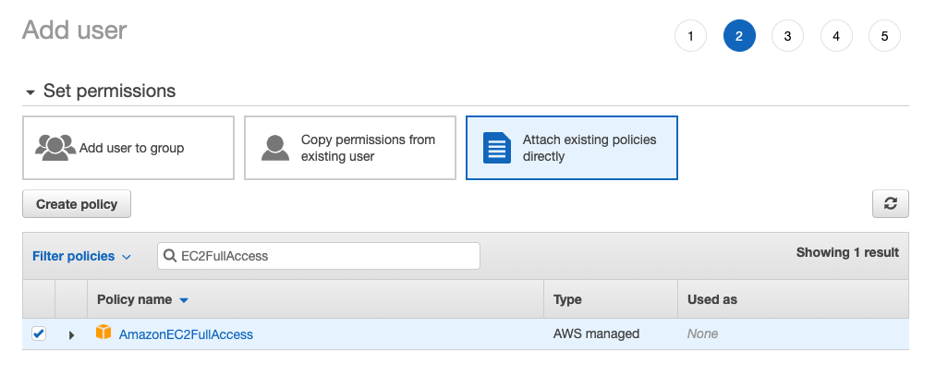
10. Search for EC2FullAccess and select it

Slide 15
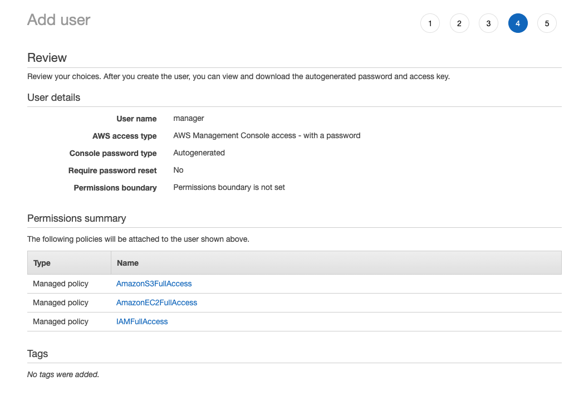
11. Click on the Next: Tags button. We don't need to add any tags at the moment, so skip the tags by clicking on the Next: Review button

Slide 16
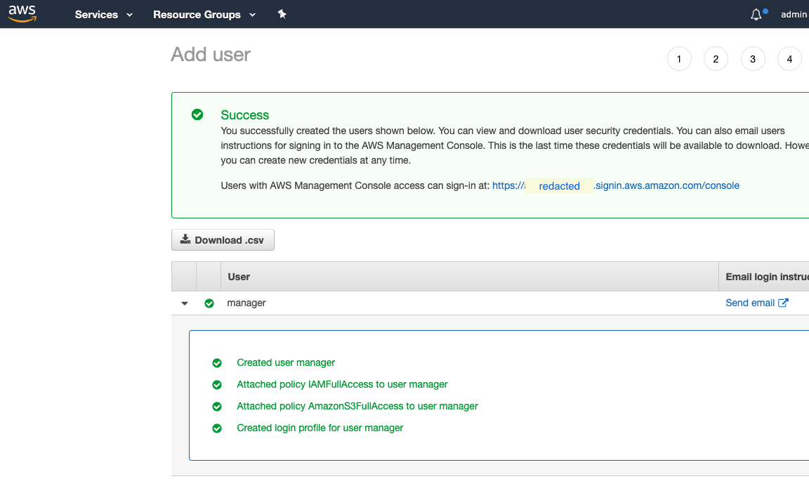
12. Click on the Create user button to create the user
Copy and save both the password (show password) and the login URL somewhere you will be able to access it later

Slide 17
Exercise: Securing IAM User With MFA
Instructions
If you have not yet done so, you must first create a manager AWS account
Install an MFA app on your phone - the Google Authenticator app (Android, iOS) is a good choice
Secure the manager account with MFA
Log out and log back in to verify that MFA is enabled
Intro to Cloud Computing https://www.udacity.com/course/intro-to-cloud-computing--ud080

Slide 18
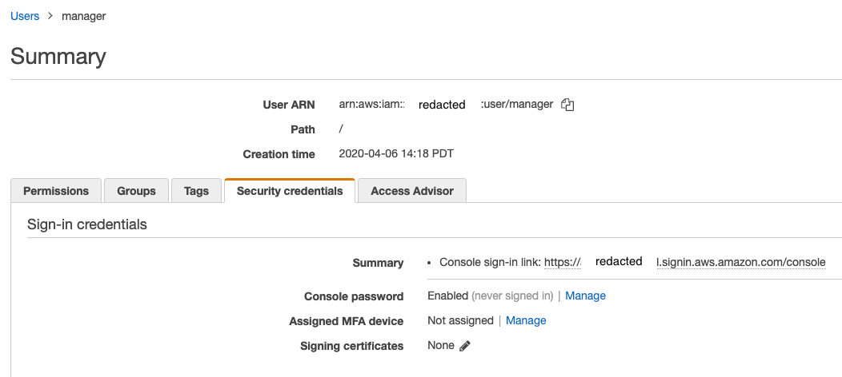
Navigate to the IAM console and select the user you want to secure with MFA (in this series of exercises this would be the manager user).
1. Click on the user account and open the Security Credentials tab

Slide 19
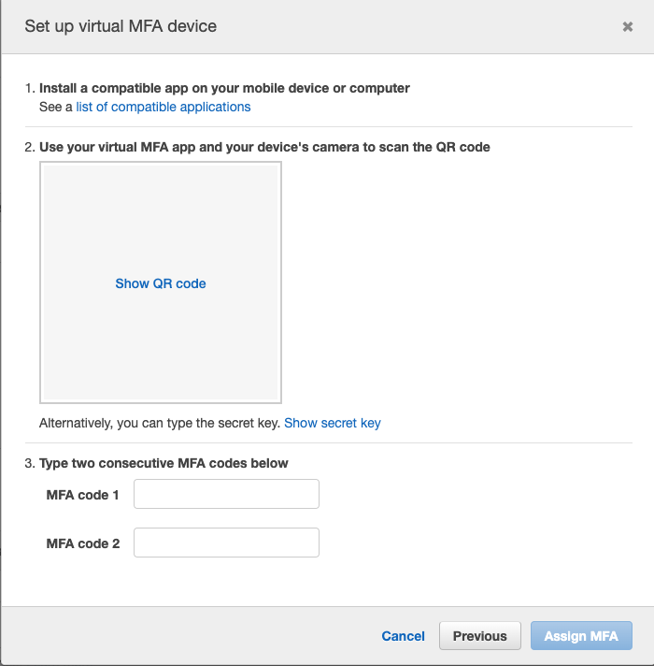
2. Click Manage next to the Assign MFA device
3. Leave the default Virtual MFA device option on and click continue
4. Click the Show QR code in the empty square

Slide 20
5. Open the Google Authenticator app on your phone and click the Scan a barcode camera icon
6. Scan the barcode
7. Type the code you see on your phone into the MFA code 1 field
8. Wait for the Google Authenticator app to generate the next code
9. Type the next consecutive code into the MFA code 2 field and click the Assign MFA button
10. Using a new incognito or private browser window to login with this user and the MFA code from your phone
If you have configured MFA correctly you should be able to log in.
If not:
Log in as the root user
Proceed to the IAM service console
Click on Users
Select the manager user
Visit the Security credentials tab
Next to Assigned MFA device, click Manage
Remove the assigned MFA device
Log out of the root user account
Log back in with the manager account
Try again to configure MFA

Slide 21
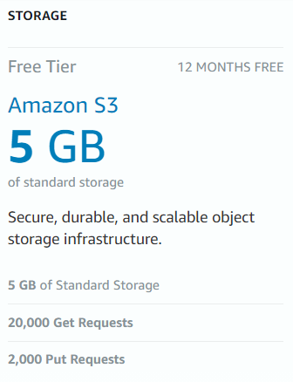
Exercise: Creating S3 Bucket And Uploading Content
Instructions
If you have not done so already, register with AWS and authenticate as the manager user
Create a bucket in the us-west-2 Oregon region
Create 2 folders in the bucket: "exercise" and "manager"
Upload content to both folders (a single file in each folder will suffice)
Note: Please do not delete the bucket until the end of this course. Deleting a bucket takes a long time. If you delete the bucket and then try to create it again later, you may run into errors.
Intro to Cloud Computing https://www.udacity.com/course/intro-to-cloud-computing--ud080

Slide 22
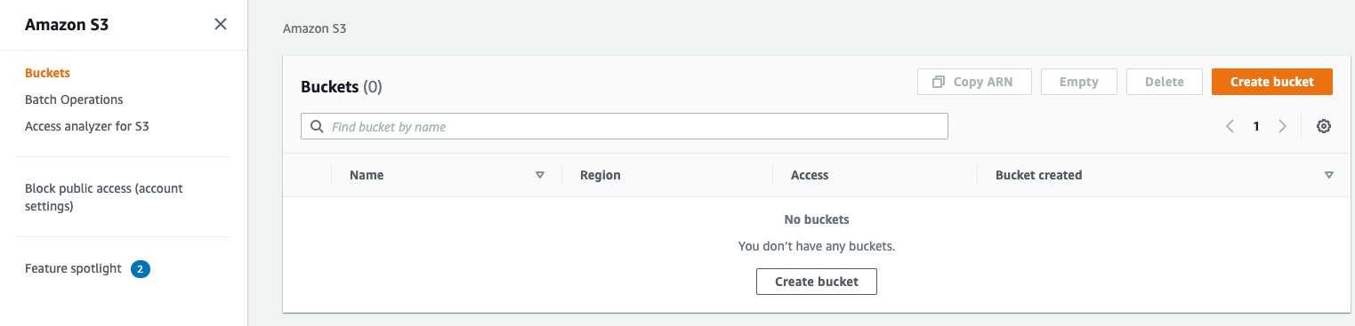
Part-1: Creating The Bucket
1. Log out of the root account user by clicking on the top right email next between the Bell icon and the Global dropdown menu
2. Log in to the console as the manager, using the information from you've got from the previous step
3. Navigate to the S3 console
4. Create a new bucket (remember that bucket names are globally unique across all AWS accounts)
Note that if a bucket name already exists you will get a warning.
Note:
Deleting a bucket takes time, so creating the same bucket name after a deletion would not allow you to create the bucket and will result in a "Bucket already exists error"

Slide 23
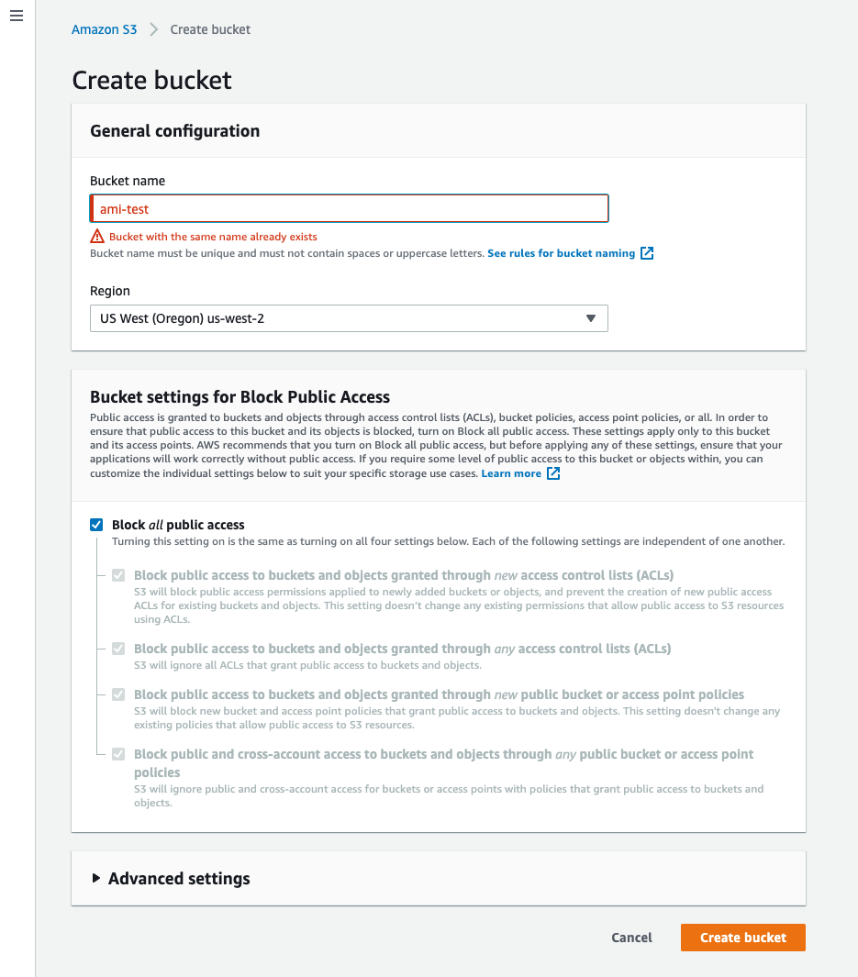

Slide 24
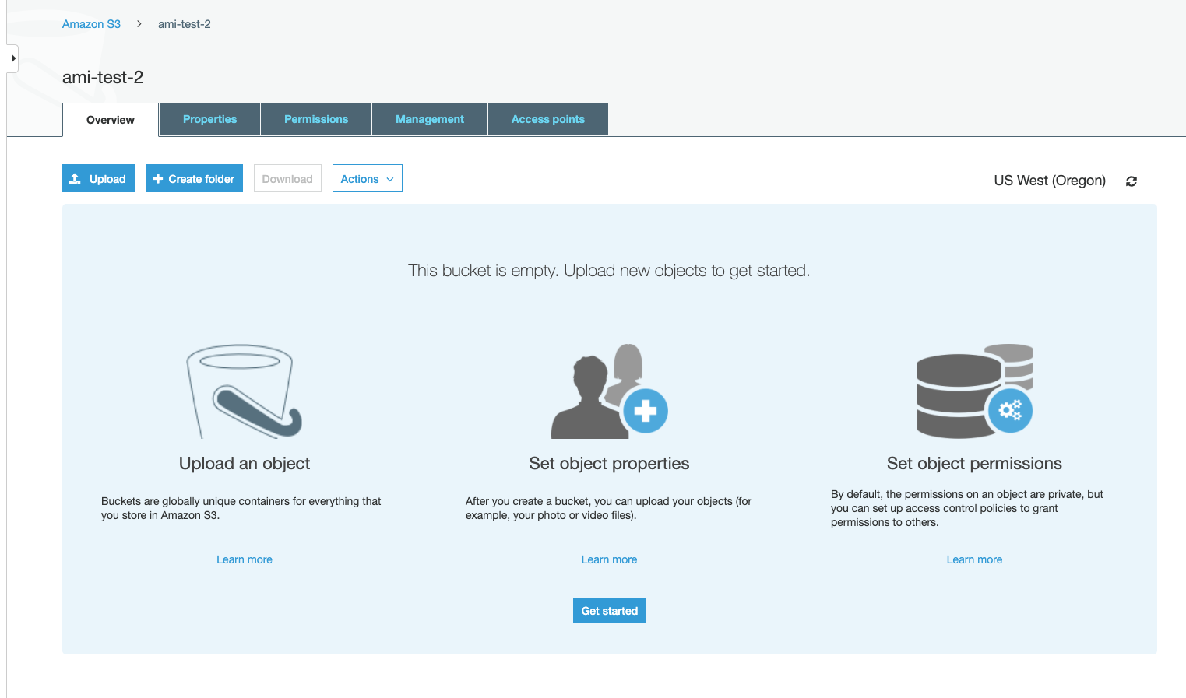
5. Once the bucket is created, click on the Create folder button to create a manager folder

Slide 25
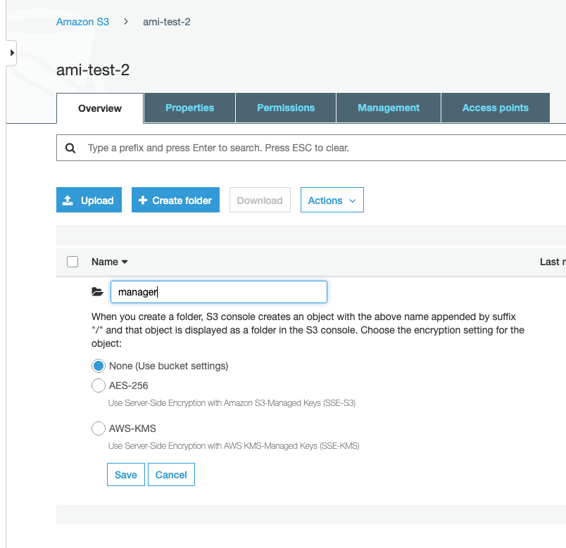

Slide 26
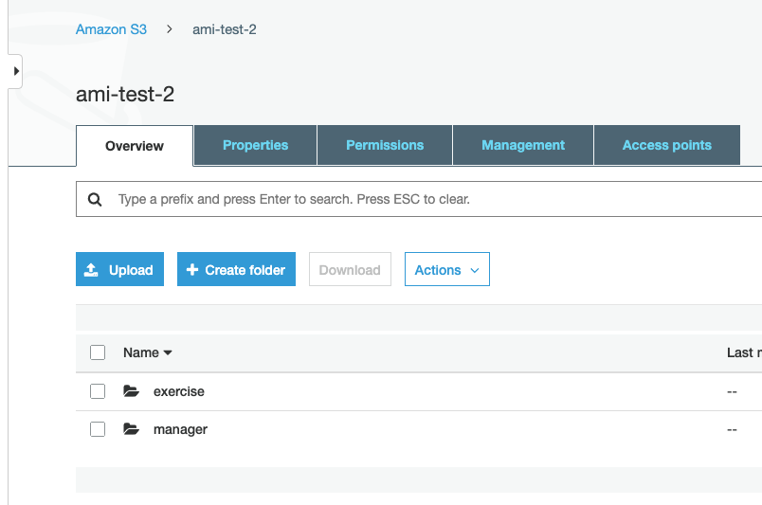
6. Create another folder called exercise

Slide 27
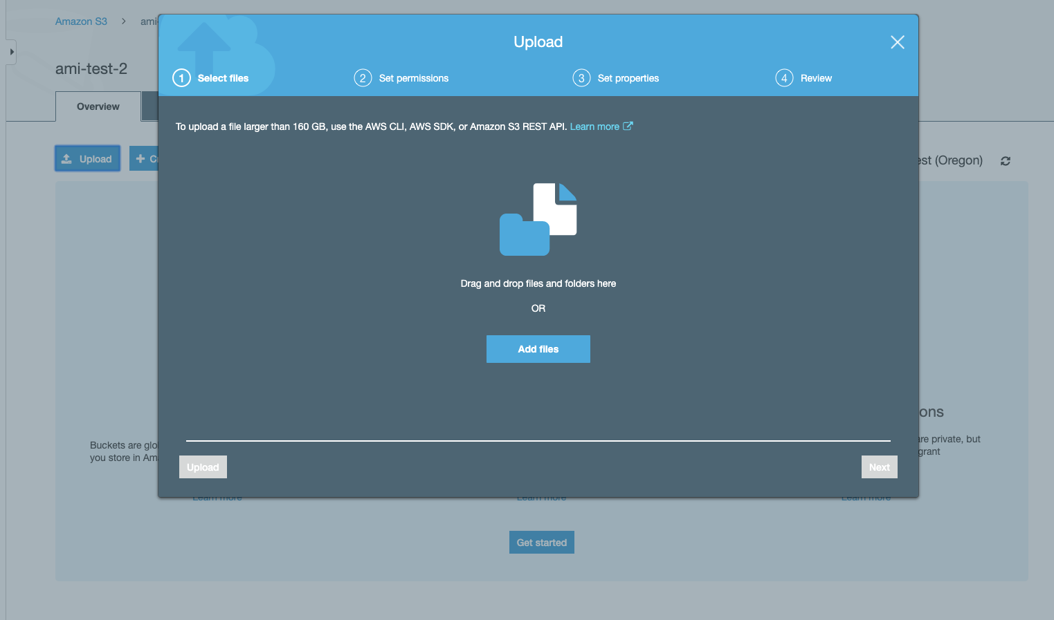
7. Click on the exercise folder to get into that folder
8. Click on the Upload button to upload a file (any file) into that folder

Slide 28
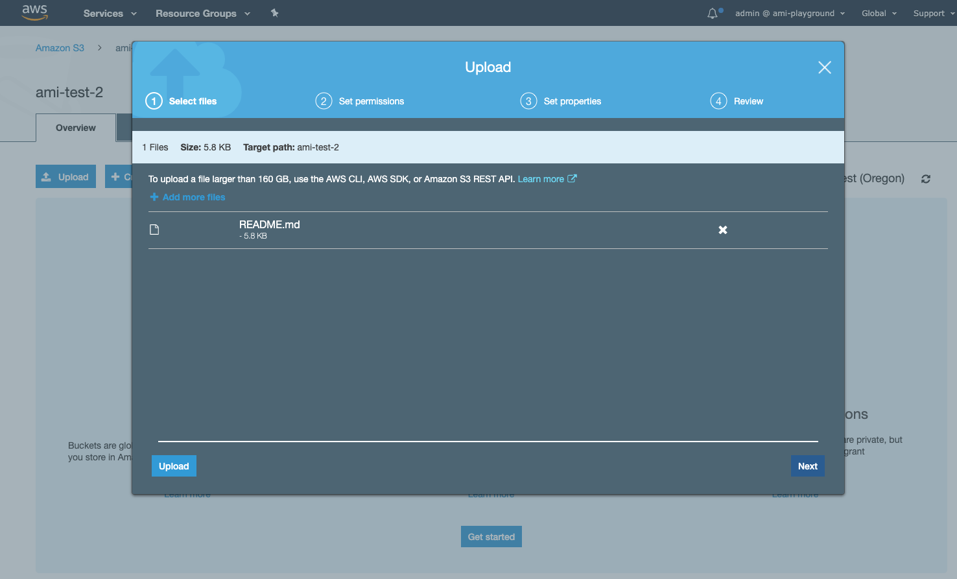
9. Either drag and drop a file onto the window or click the Add files button to start the upload process

Slide 29
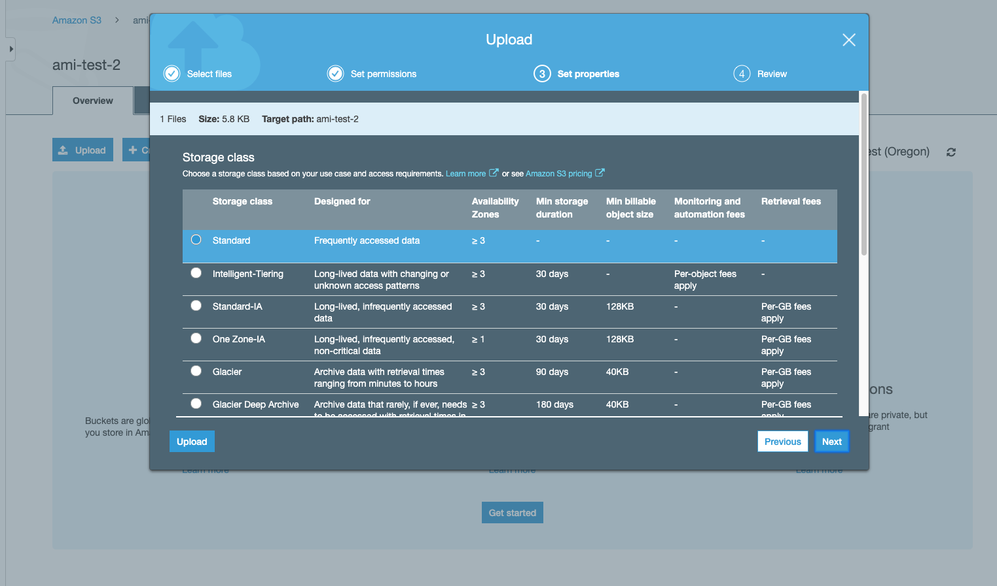
10. Click the Next button to see the list of default permissions for this file (we will use IAM permission to access it rather than resource permissions)
11. Click Next to see the S3 storage classes, and leave the default Standard class selected

Slide 30
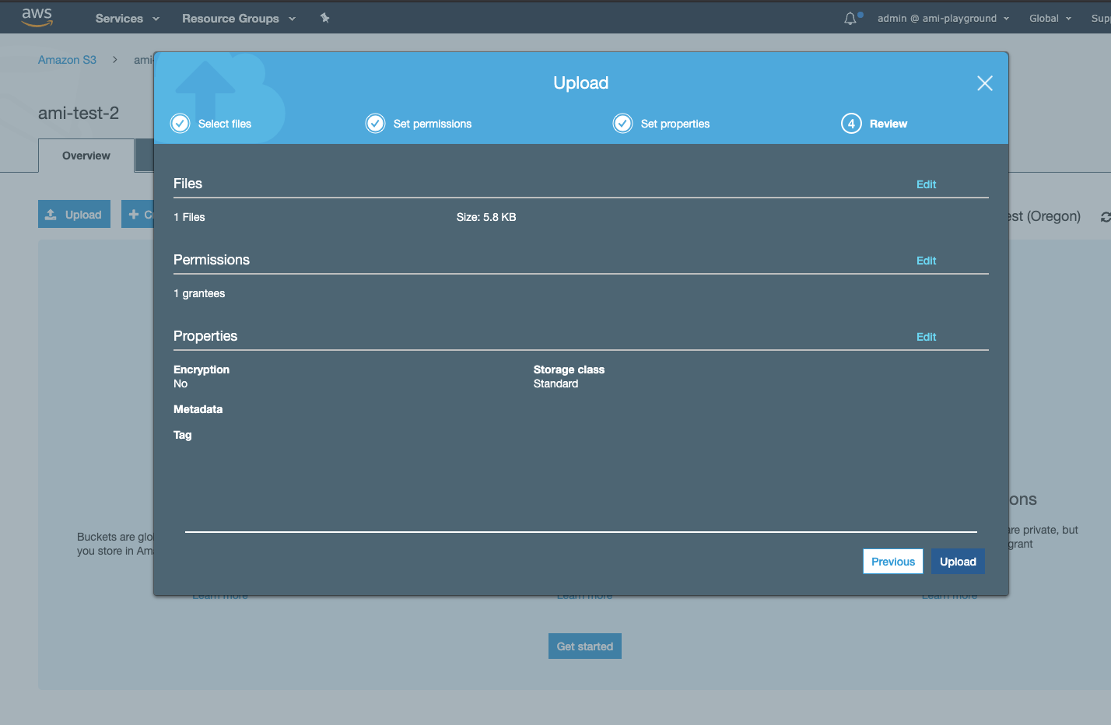
12. Click the Upload button to start the upload.

Slide 31
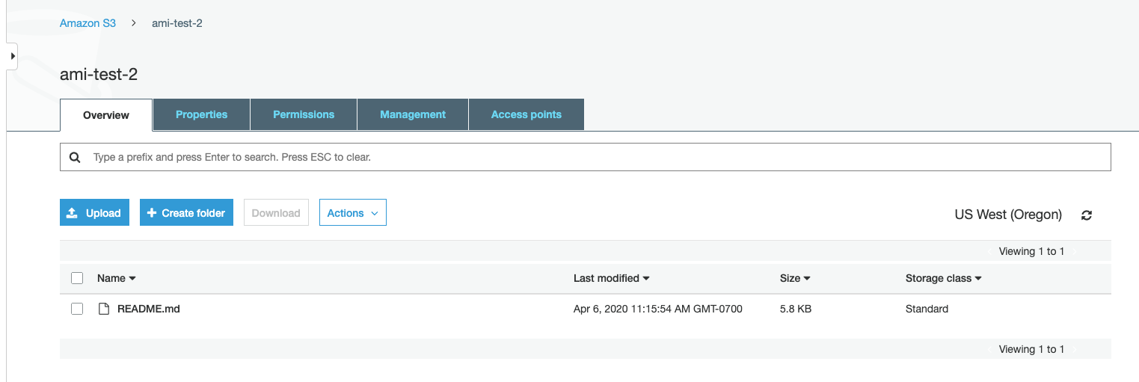

Slide 32
Monitoring your AWS costs
All AWS services are a pay-as-you-go service, so we urge our students to closely monitor their usage costs and if they have adequate credits available to complete their project/task. Follow the instructions below to do that:
Step 1. Log into your AWS account.
Step 2. Examine your costs
Go to https://console.aws.amazon.com/billing/
You should see the following billing dashboard where it will show your costs.
Intro to Cloud Computing https://www.udacity.com/course/intro-to-cloud-computing--ud080

Slide 33
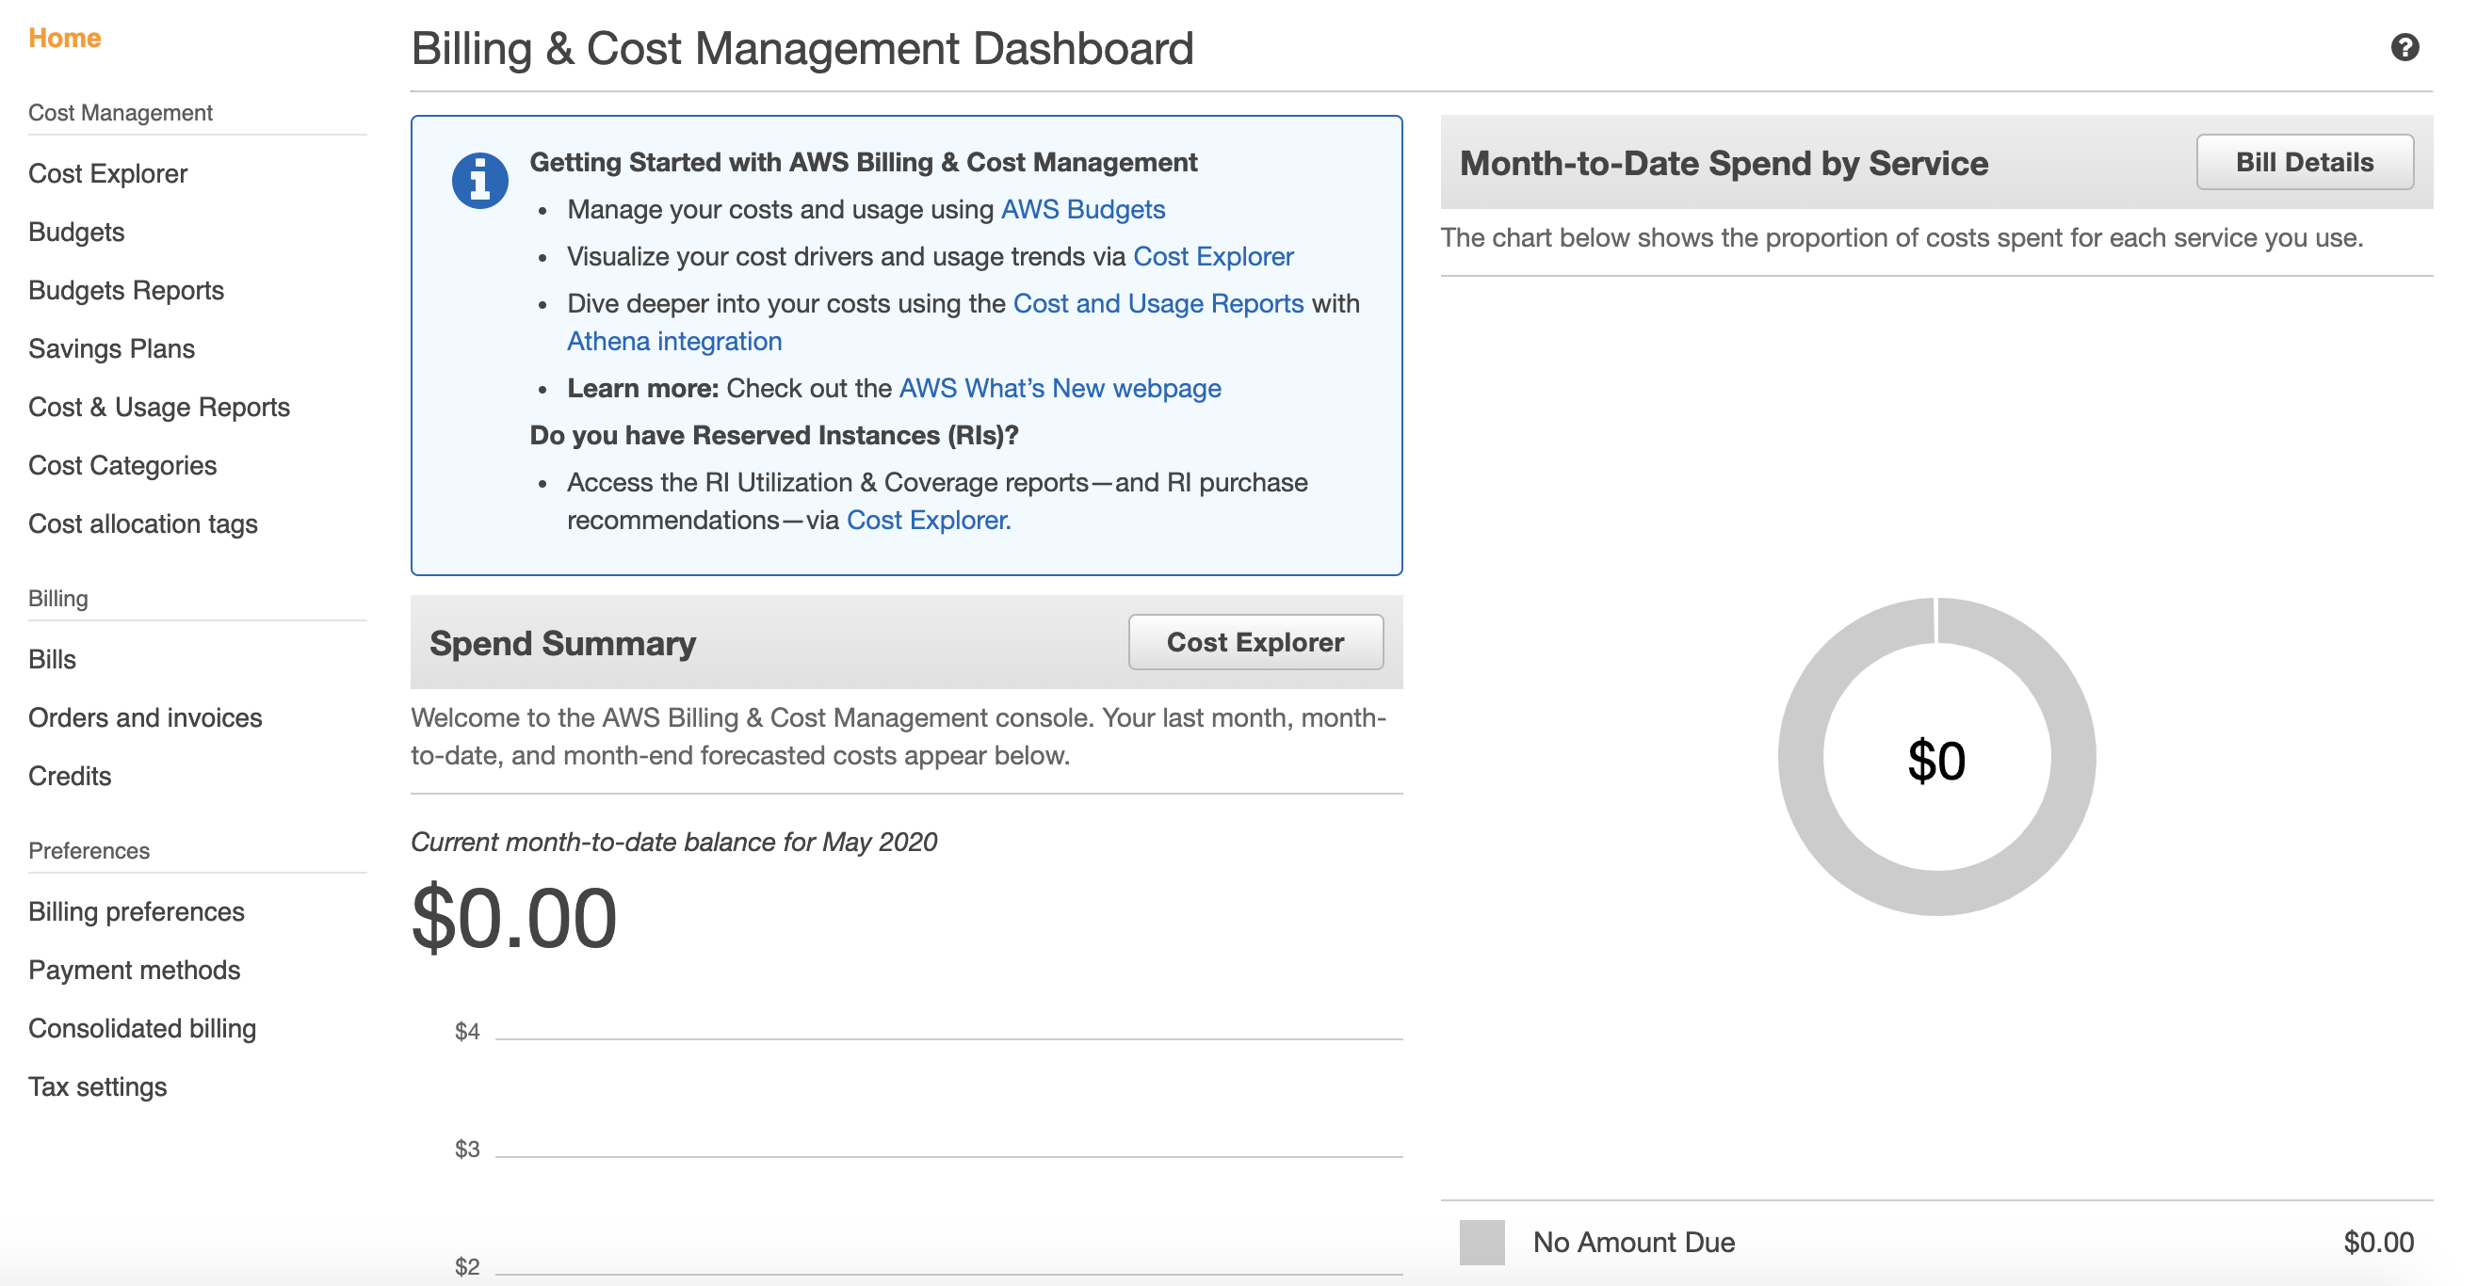
Monitoring your AWS costs
Intro to Cloud Computing https://www.udacity.com/course/intro-to-cloud-computing--ud080

Slide 34
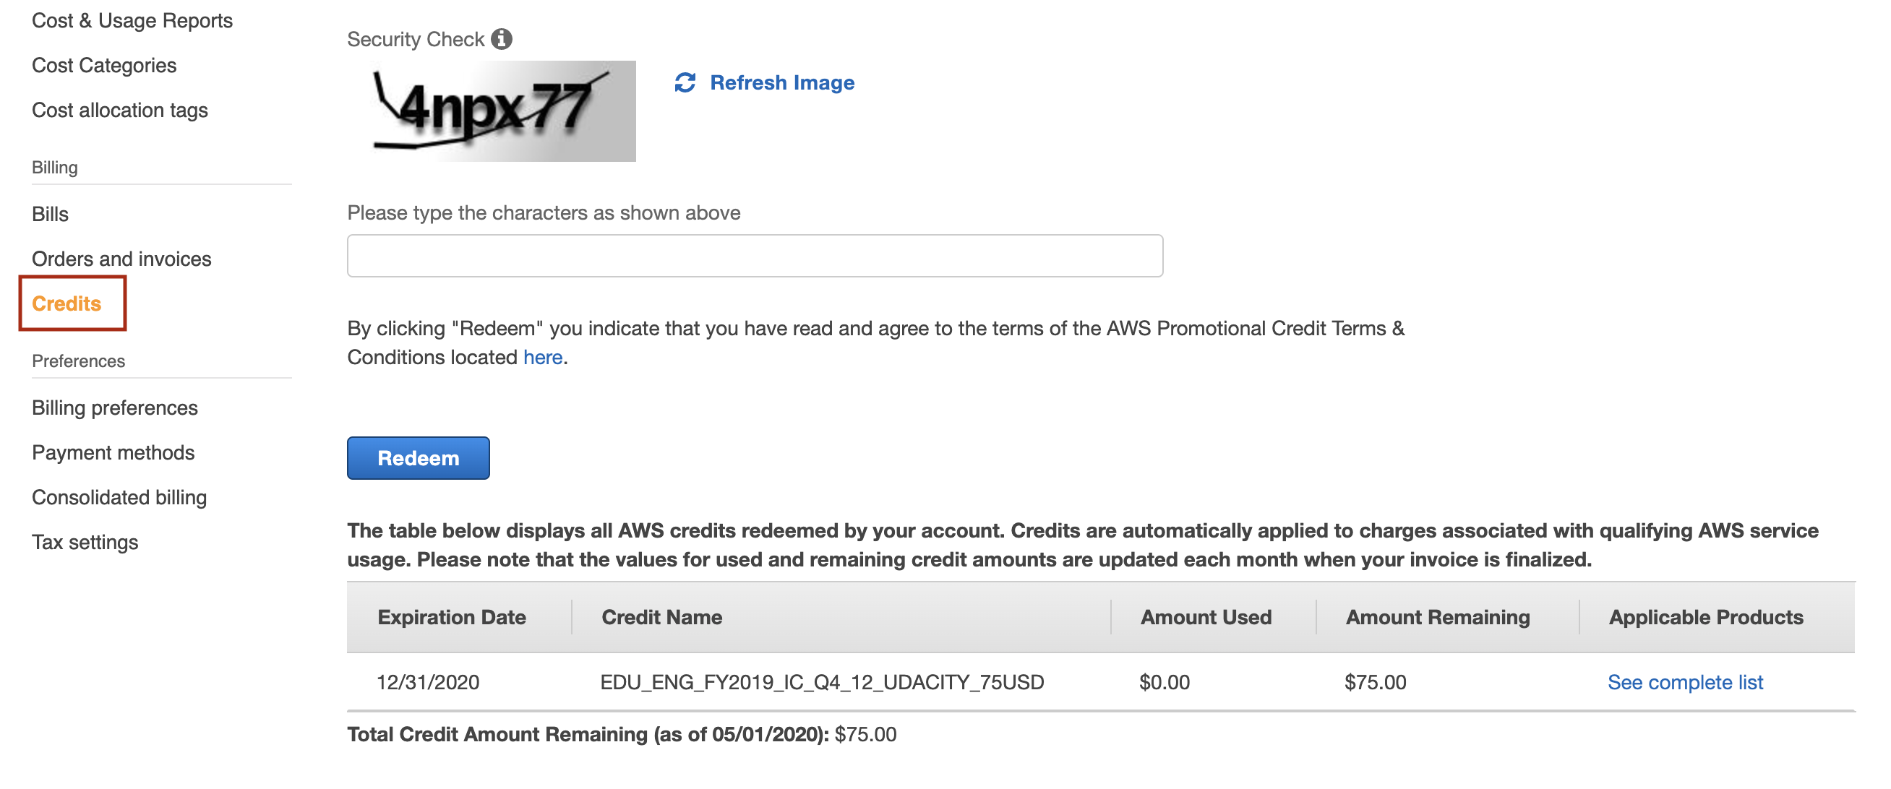
Monitoring your AWS costs
Step 3 (optional). Check the value of your credits.
Click on the "Credits" from the left side menu and the following screen will show with your available credits.
Intro to Cloud Computing https://www.udacity.com/course/intro-to-cloud-computing--ud080

Slide 35
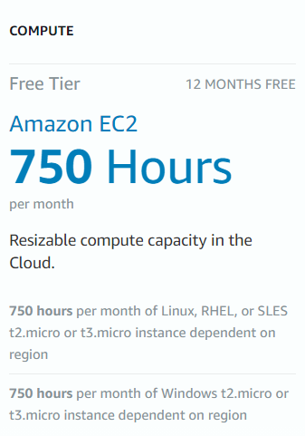
AWS Elastic Compute Cloud (EC2)
Resizeable, scalable compute capacity
Instances sizes are predefined by instance types
Configuring an instance can be done within the EC2 Launch Wizard:
  Security groups (i.e. firewall rules)
  Networking (public or private)
  Storage size and type
  Custom provisioning scripts
Intro to Cloud Computing https://www.udacity.com/course/intro-to-cloud-computing--ud080

Slide 36
Exercise: Launch An E2 Instance
In this exercise, you will launch an EC2 instance.
No need to connect to this instance using a key pair.
Instructions
Region: us-east-1
AMI: Amazon Linux 2 AMI (HVM), SSD Volume Type 64-bit
Type: t2.micro (Free Tier = 750 hours per month)
Root volume size: 20GB
IP: Public
Intro to Cloud Computing https://classroom.udacity.com/courses/ud080/lessons/ac7396e3-43f7-46b2-8f8b-c69d67dbe220/concepts/a0838cc9-9e64-44ae-80fe-cf411968610b

Slide 37
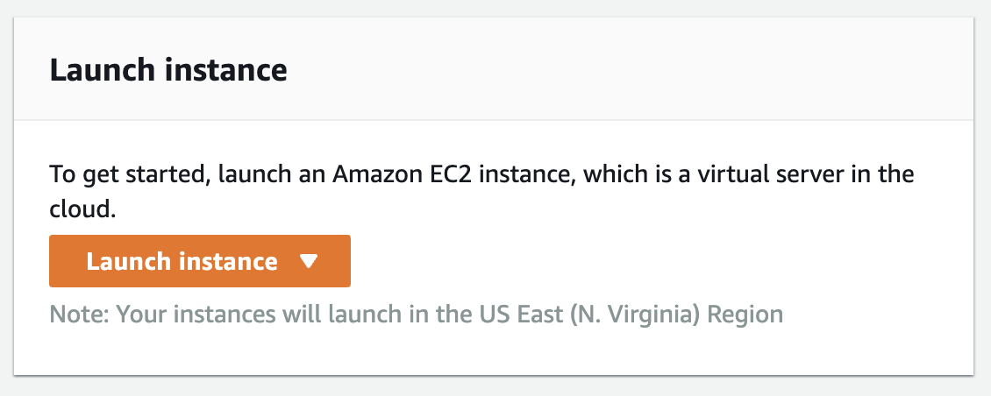
Use the us-east-1 N.Virginia region to launch an EC2 instance with the following configuration:
AMI: Amazon Linux
Instance type: t2.micro
IP: Public
Storage size: 20GB
Intro to Cloud Computing https://classroom.udacity.com/courses/ud080/lessons/ac7396e3-43f7-46b2-8f8b-c69d67dbe220/concepts/382c4f04-93fa-4adc-a1ba-03a161b95300

Slide 38
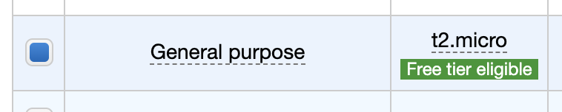
Choose the Amazon Linux 2 AMI (HVM), SSD Volume Type 64-bit image.
Select the t2.micro option and click the Next: Configure Instance Details button.
Skip the defaults for VPC and Subnet
Change the Auto-assign Public IP field from the default disabled to Enable and then click Next: Add Storage button
Change the default size from 8GB to 20GB
Intro to Cloud Computing https://classroom.udacity.com/courses/ud080/lessons/ac7396e3-43f7-46b2-8f8b-c69d67dbe220/concepts/382c4f04-93fa-4adc-a1ba-03a161b95300

Slide 39
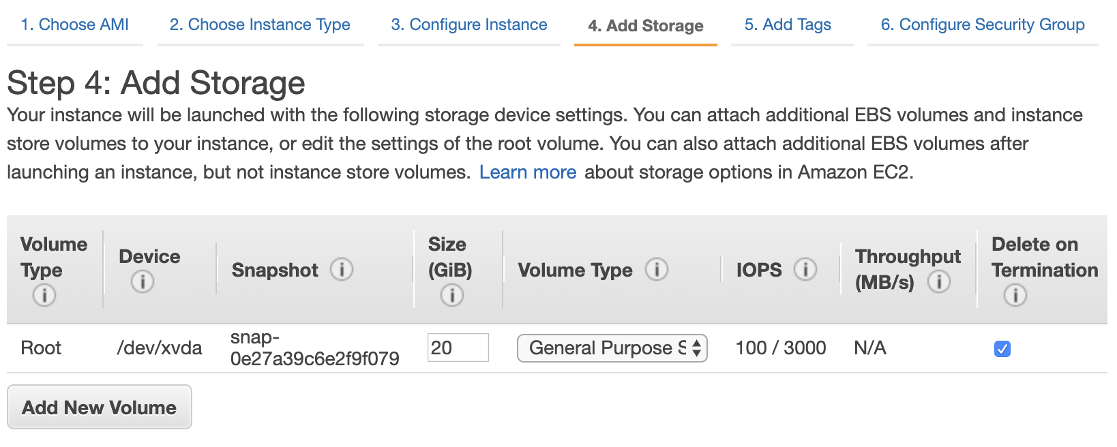
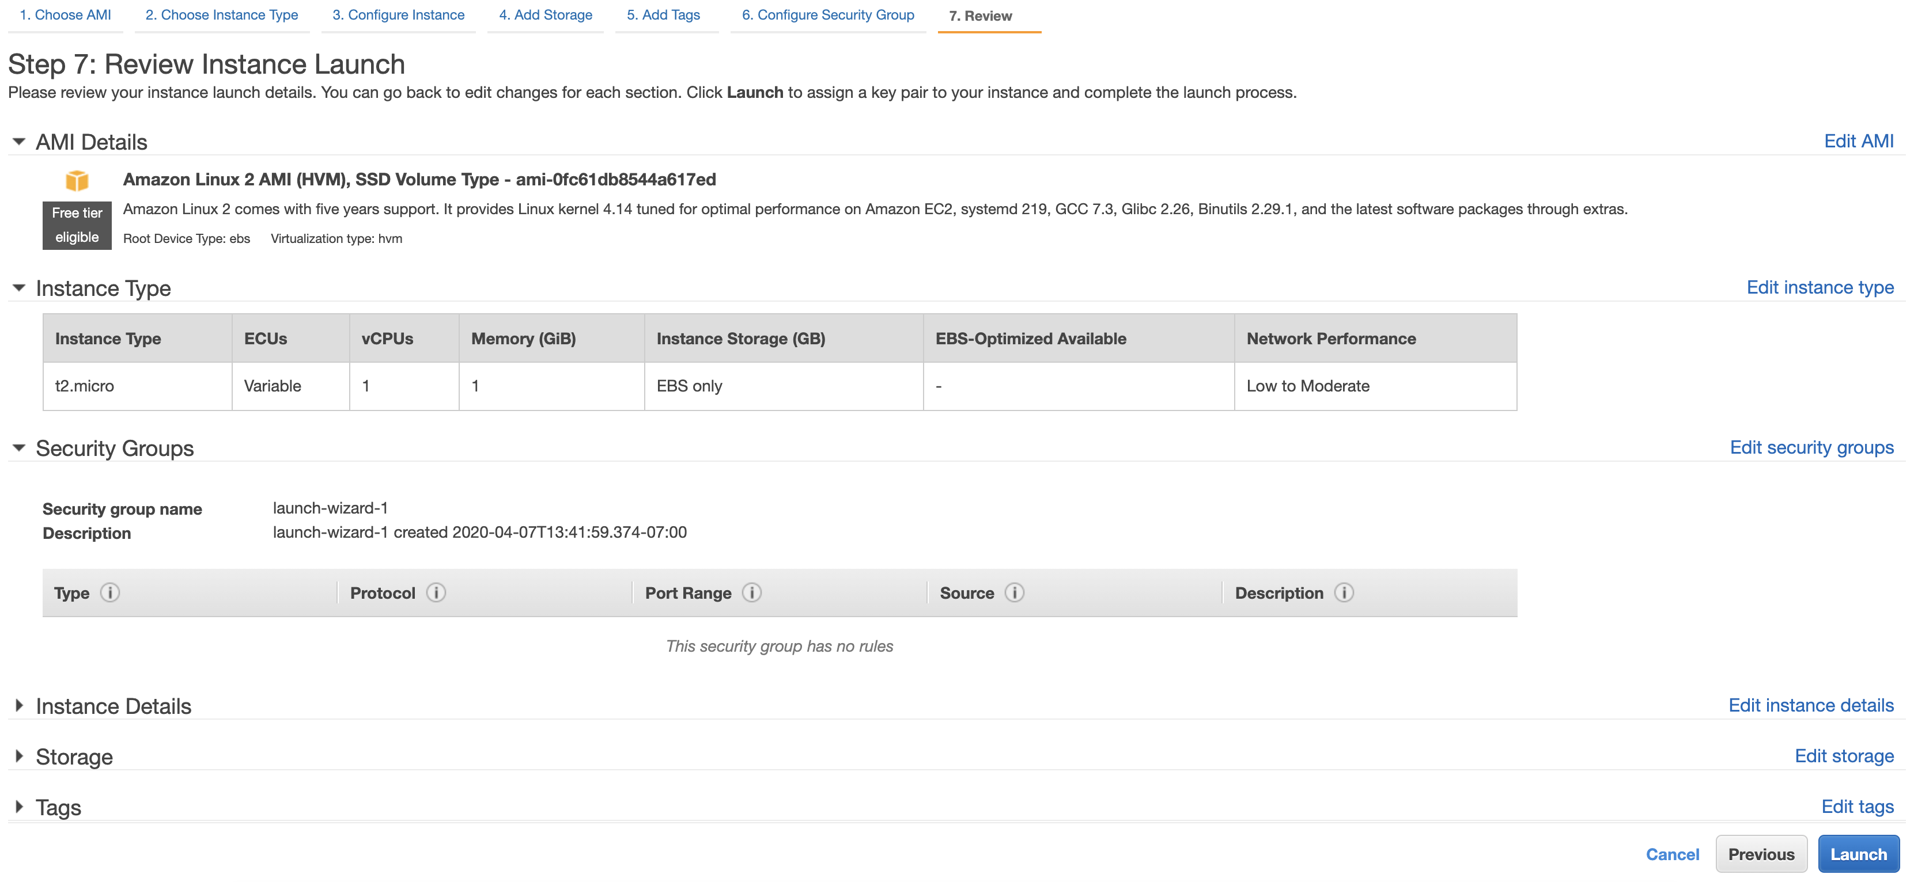
Since we do not need any further configuration we can click on the Review and Launch button.

Slide 40
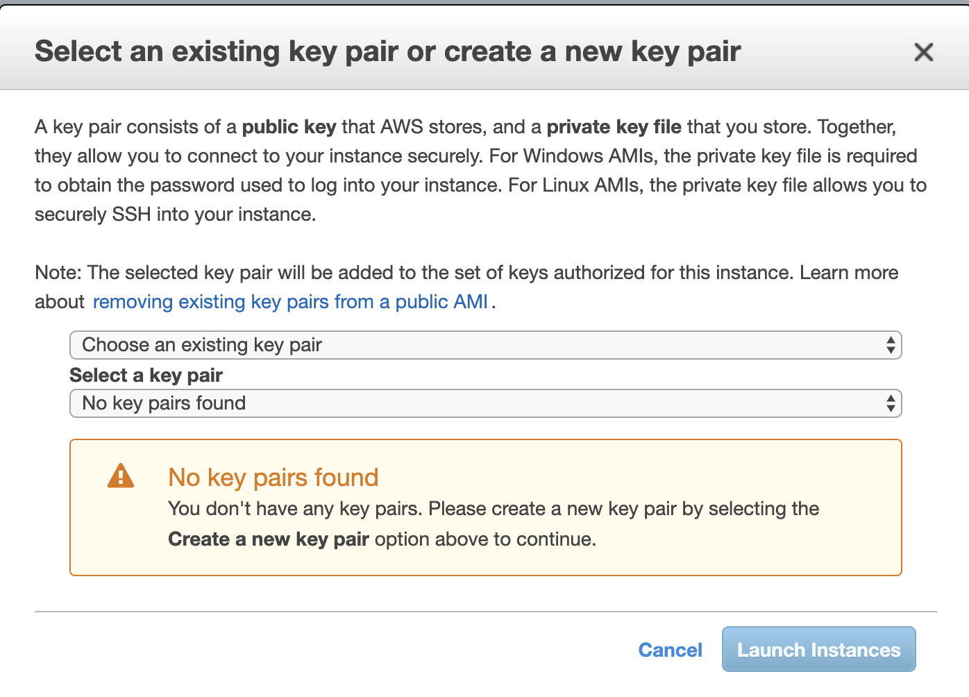
Choose to proceed without an SSH key pair.

Slide 41
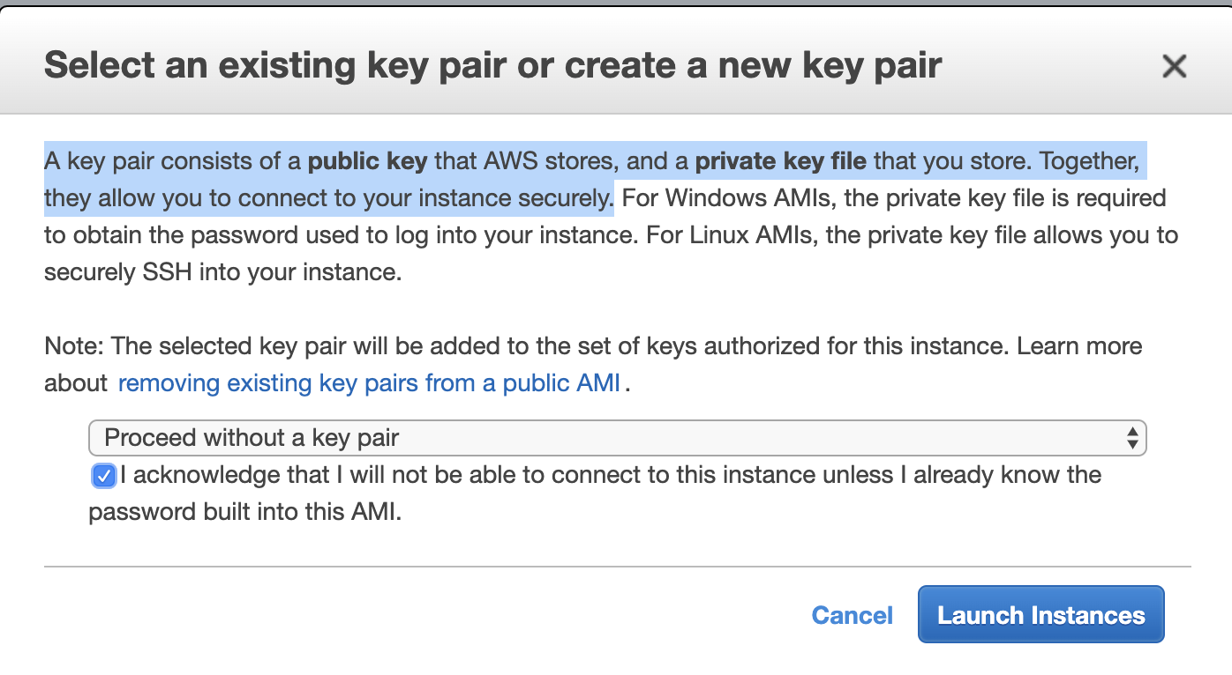
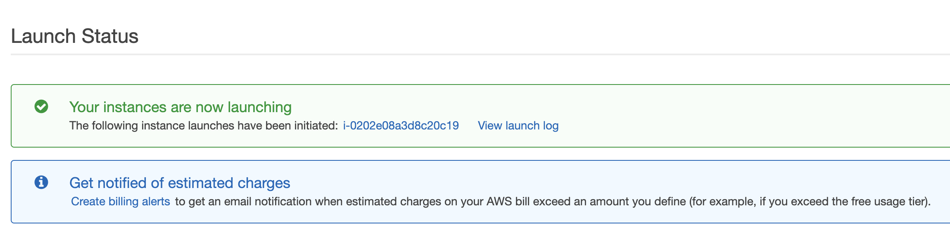
For this exercise, we can skip the creation of a new key pair, and acknowledge that we will not be able to connect to the instance.
Select Proceed without a key pair and check the box for I acknowledge that.... Then click on the Launch Instances button.

Slide 42
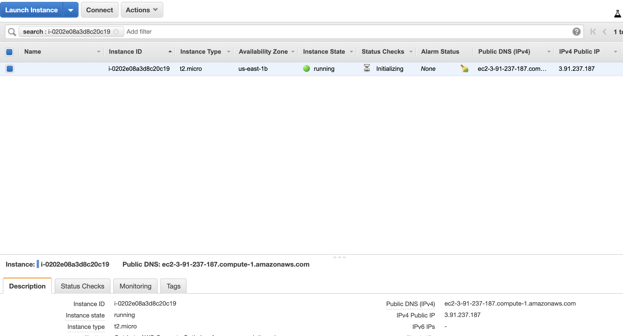
Every instance has an ID. If we click on the ID starting with the prefix i- we can see the instance.
In this page we can verify that:
Our instance type is: t2.micro
An IPv4 Public IP has been allocated
The instance is running
  The instance may first take several minutes to boot

Slide 43
Security Group
Acts as a firewall
Ingress rules can be added to allow traffic to specific services and ports
Security groups are scoped to an instance level, not to a network or subnet
You can specify ALLOW rules but you can't specify DENY rules
You can control traffic via an IP address range (CIDR), or via security group IDs (for other AWS resources)

Slide 44
Exercise: Security Group
In this exercise, you will create a security group to allow traffic to an instance.
Instructions
If you have not done so already, launch an EC2 instance
Create a new Security Group allowing Port 80 and Port 22 Inbound traffic from anywhere (any IP address)
Attach the security group to the instance

Slide 45
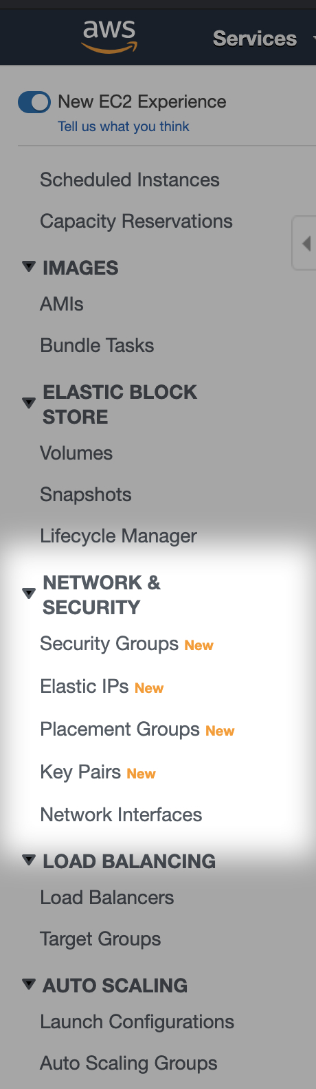
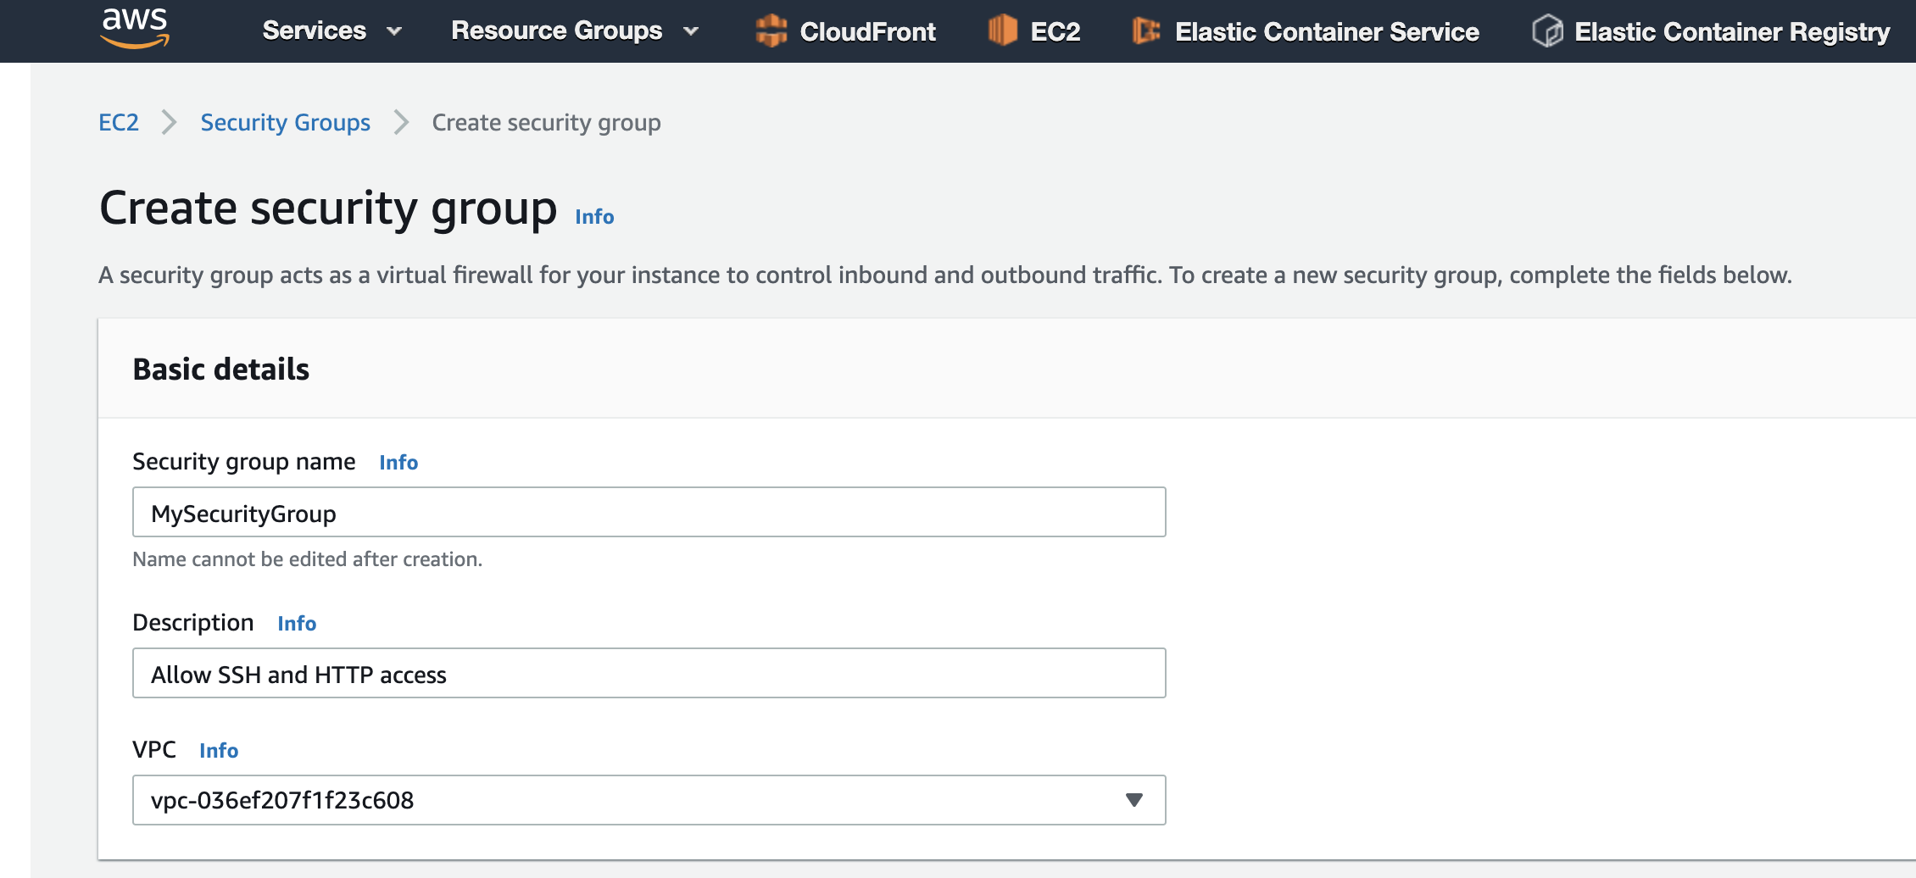
Part 1: Create a Security Group
From the EC2 console, scan the sidebar to find the Network & Security section. Within that section click on Security Groups.
Click on the Create security group button
Fill the information for your security group name and description.

Slide 46
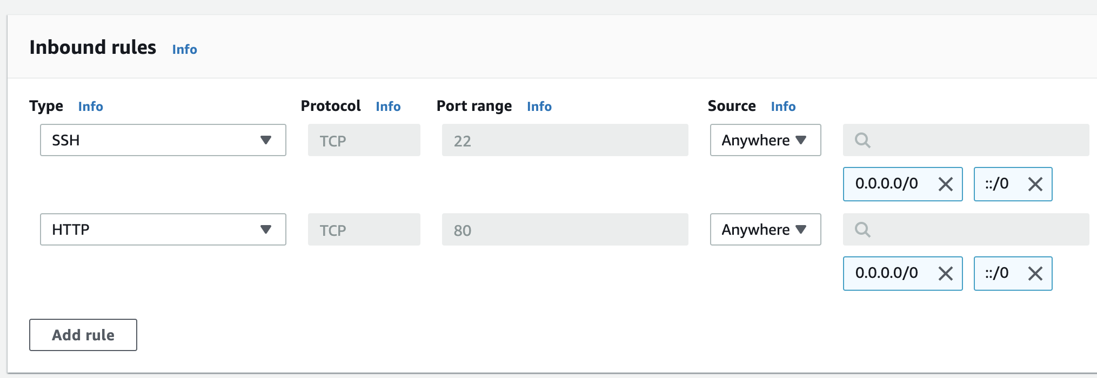
Click on the Add Rule button under the inbound section and add the following rules:
SSH TCP 22 Anywhere
HTTP TCP 80 Anywhere
Click on the Create security group button to create the security group.

Slide 47
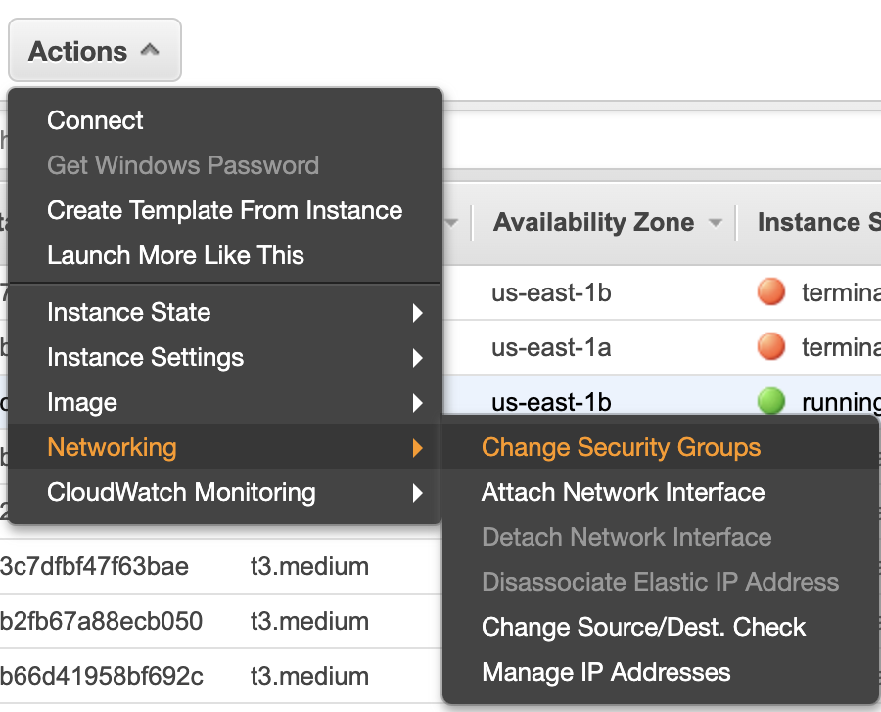
Part 2: Attach The Security Group To An EC2 Instance
Navigate via the sidebar to EC2 Instances Dashboard. Select the instance to which you want to add the security group.
From the Actions dropdown menu select Networking, followed by Change Security Groups.

Slide 48
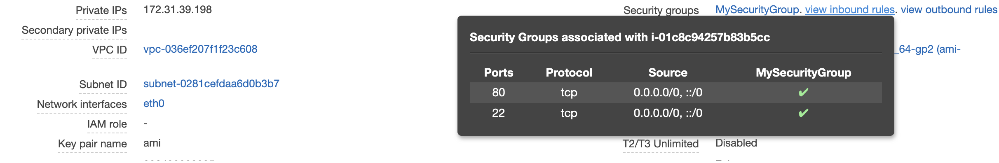
Select the security group you just created in Step 1 and click the Assign security groups button.
In the Description tab at the bottom of the screen, we can now see the security group.

Slide 49
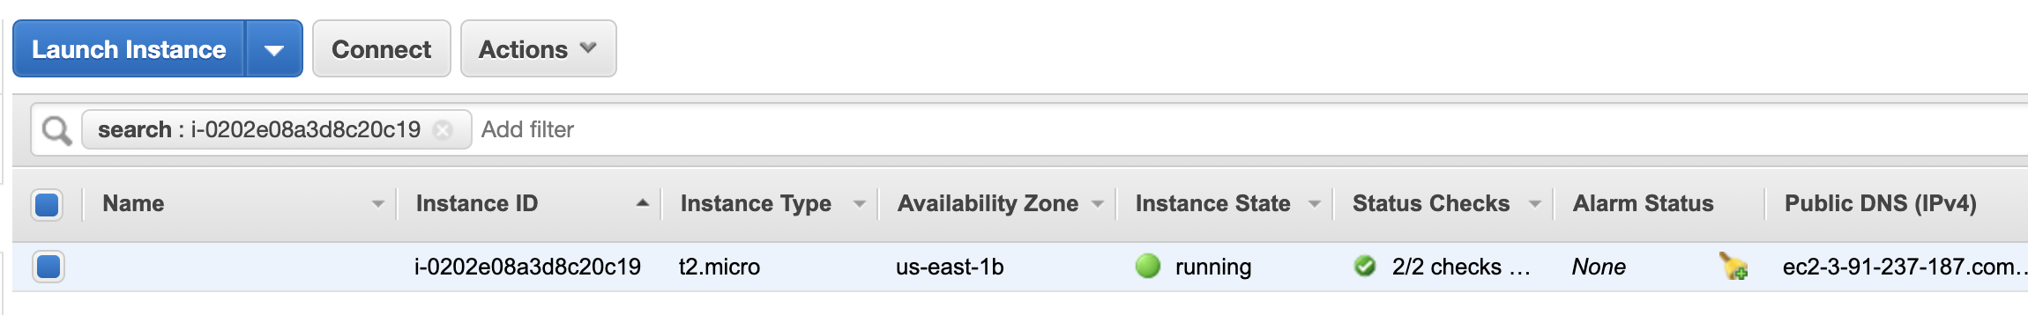
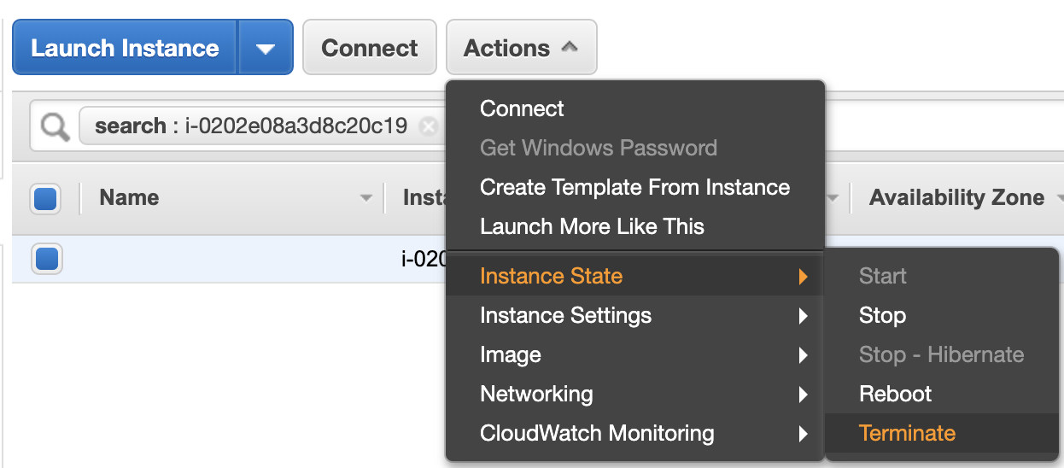
Exercise: Terminate Instance
Now that you have practiced launching an EC2 instance, let's practice cleaning up (i.e. terminating) that instance. Cleaning up resources is important so that we don't incur any unexpected charges.
Select the instance ID from the AWS Instances console.
From the Actions dropdown menu, select Instance State, followed by Terminate.
Confirm that the instances reaches the Terminated state. This may take a few minutes.

Slide 50
Init Script
An init script can be configured on instance launch page under userData section
Can be used to run commands, install and configure an instance only during first boot
Can be configured to run on every reboot
Instances must have a public IP to install software from the internet
Can be written in any language if the instance image AMI has the required software, mainly written in Bash

Slide 51
Exercise: Init Script
In this exercise, you will automatically provision an EC2 Instance using an init script, which runs at first boot.
Instructions
EC2 instance AMI: Amazon Linux AMI 2
Instance type: t2.micro
Instance should be open for traffic from anywhere on port 80
Instance must have a public IP address to be able to reach the internet and install NGINX
For this exercise, we can ignore SSH permissions, as we do not need them.
Use this code as the init-script:
#!/bin/bash
yum update -y
amazon-linux-extras install nginx1.12 -y
service nginx start
Goal
We should be able to access the instance's public IP address via a web browser. The NGINX default page should appear: Welcome to NGINX.

Slide 52
Exercise: Init Script
When you launch an EC2 instance, you have the option of passing user-data that you can use to configure or install software on your instance.
This is also known as an "Init script". For this exercise solution, we will program a shell script to be our init script.
By default, Init scripts run only on the first boot of the instance. We can configure an existing instance to run its init script on every restart, but we do not need that for this exercise.
Part 0: Clean Up
If you haven't already, terminate all previous instances by selecting them in the EC2 Instances Dashboard. From the Actions dropdown menu select Instance state, followed by Terminate.

Slide 53
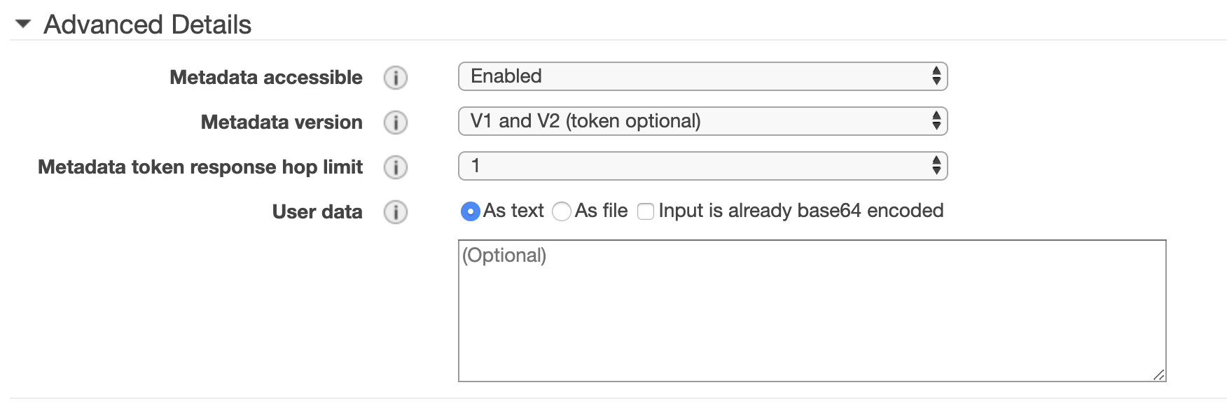
Part :1 Launch an EC2 Instance
Using the EC2 Console, select Instances from the sidebar and click Launch instance
Select t2.micro instance type and click the Next: Configure Instance Details button
Set the Auto-assign public IP to Enabled, because we need an Internet connection to install the NGINX software
Scroll down to the Advanced Details section, where we will configure the init script to install the NGINX server

Slide 54
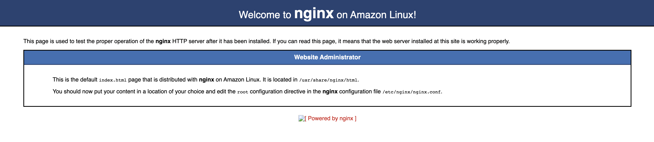
5. Copy the following commands into the User data box
#!/bin/bash
yum update -y
amazon-linux-extras install nginx1.12 -y
service nginx start
6. Click Review and Launch, then edit the Security Groups
7. Either select an existing security group that allows HTTP access, or create a new such security group
8. Click Review and Launch and then launch the EC2 instance
9. Find the instance's IPv4 Public IP address from the EC2 Instance Dashboard
10. Visit the IP address in the browser and you should see the default Nginx page

Slide 55
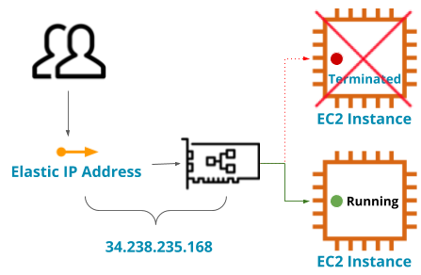
Elastic IP
Allocate a public, static IP address that can be associated with an instance
Reachable from the internet
Once associated, it becomes the public IP of the instance
You can not have 2 public IP address per instance
Can be disassociated from an instance
You only pay for unassociated Elastic IPs

Slide 56
Exercise: Elastic IP
In this exercise, you will allocate an Elastic IP and assign it to your instance.
Instructions
If you have not done so already, launch an EC2 instance
Allocate an Elastic IP
Associate the Elastic IP with your EC2 instance
Verify that the Elastic IP address works

Slide 57
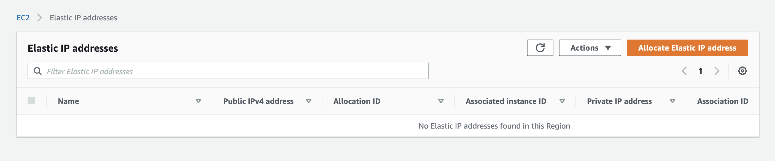
Exercise: Elastic IP
By default, EC2 instances do not get a public IP address. Even If you do assign an automatic public IP address in the Launch Wizard, the address will change on the next restart.
Elastic IP is a way to maintain the same external public IP address for an Instance or application.
From the EC2 console sidebar menu, under the Network & Security section click on Elastic IPs .

Slide 58

Click on the Allocate Elastic IP Address button to allocate a new IP address out of the AWS IPv4 pool.

Slide 59

Click on the Allocate button.
The newly-created Elastic IP address is not associated with any instance. Click on the Associate this Elastic IP address button, or select it and from the Actions dropdown and choose Associate Elastic IP Address.

Slide 60

In the next window, in the instance field, select the instance with which you want to associate the Elastic IP address.

Slide 61


Once the instance is associated, you can click on Associated Instance ID to see the instance's details. On that screen, you can see the Elastic IP next to the instance ID. You can also verify that the Elastic IP address is the same as the instance's IPv4 Public IP.

Slide 62

IAM Role
An IAM identity that does not have long-term credentials
Can be assumed by a trusted service and operate on your behalf
Designed for service-to-service communication
Defines a set of permissions for accessing AWS services
Is not bound to an identifiable user

Slide 63
Exercise: IAM Role
In this exercise, you will create an IAM role with a read-only policy to an S3 bucket.
Instructions
If you have not already done so, create an S3 bucket with a folder inside
Create an IAM Role
Attach an Inline IAM Policy allowing Read-Only access to that S3 bucket

Slide 64
Exercise: IAM Role
An IAM Role is an IAM identity similar to IAM user. Instead of uniquely associating with a person, a role is designed for anyone who needs to assume it. This is an excellent fit for a service or a server-to-server identity.
A role is more secure than the long-lived credentials of an IAM user because when the role is assumed it provides temporary security credentials that expire and renew every 15 minutes
Create the IAM Role
Navigate to the IAM console
Click Roles on the sidebar menu
Click on the Create Role button
Since we intended to use the role on an EC2 in the next exercise, choose EC2 as the use case, and click on Next: Permissions button

Slide 65


5. If we were to click on the Create Policy button, the role creation would be canceled, so instead click on Next until you get to the review page
6. Name the role web and click on the Create Role button

Slide 66


Creating and Attaching an IAM Policy to the Role
Now that we have a role, let's create an IAM policy so that it can access our S3 bucket.
From the sidebar menu click on Policies and then click on the Create Policy button
Select S3 for the service
On the Actions field select ListBucket and GetObject
Click on Resources, while it is set to specific click the Add ARN for the bucket and add your bucket name (instead of <your-bucket-name> on image below)
Click on the Add ARN for the object, set the bucket name again to your bucket name and set the object name to "web/*"

Slide 67


7. Click on the Review policy button, set a name (for example, "ec2_web_s3_access") and click the Create policy button

Slide 68



Attaching the Policy to the IAM Role
Click on the Roles on the sidebar menu of the IAM console
Search for the role "web"
3. Click on the role name to edit the role
4. Click on the Attach policies button
5. Search for "web" to find the policy you just created
6. Select it and click the Attach policies button

Slide 69
Overriding NGINX Defaults
NGINX comes with a default web page to verify that the webserver is working.
Instead of configuring a new site for NGINX, we can copy a website to this default location. Our new website will replace the existing NGINX default.
We will store this content in an S3 bucket under the web folder. In order to access this content, the following prerequisite must exist:
S3 bucket storing the zip file for the SB Admin 2 theme
IAM role and policy for EC2 to access the bucket
Provisioning Script
Note: Make sure to change "BUCKET_NAME" to the name of the bucket you created
#!/bin/bash
BUCKET_NAME=<s3-bucket-name-place-holder>
yum update -y
amazon-linux-extras install nginx1.12 -y
service nginx start
aws s3 cp s3://${BUCKET_NAME}/web/startbootstrap-sb-admin-2-gh-pages.zip /tmp/
cd /tmp
unzip start*
mv startbootstrap-sb-admin-2-gh-pages html
rm -rf /usr/share/nginx/html
mv /tmp/html /usr/share/nginx/

Slide 70
Exercise: Overriding NGINX Defaults
In this exercise, you will launch an EC2 instance with an IAM role and pull static website content from an S3 bucket to overwrite the default NGINX website.
Exercise Requirements
Prerequisites
Download zip file for Bootstrap SB2 Admin Theme Site
Upload the zip file to your S3 bucket under a folder called web (do not extract it)
EC2 Requirements
AMI: Amazon Linux 2
IP Address: Public
Type: t2.micro
IAM Role: web (created in the previous exercise)
Security group: accessible from anywhere on port 80
Init Script: see below

Slide 71
Exercise: Overriding NGINX Defaults
Init Script
Copy the following script into the User data text box in the EC2 Instance Launch Wizard.
Note: you must change the to your bucket name (with no spaces after the = sign)
#!/bin/bash
BUCKET_NAME=<s3-bucket-name-place-holder>
yum update -y
amazon-linux-extras install nginx1.12 -y
service nginx start
aws s3 cp s3://${BUCKET_NAME}/web/startbootstrap-sb-admin-2-gh-pages.zip /tmp/
cd /tmp
unzip start*
mv startbootstrap-sb-admin-2-gh-pages html
rm -rf /usr/share/nginx/html
mv /tmp/html /usr/share/nginx/
Goal
You should be able to see the SB Admin 2 web page with images displayed in the browser.

Slide 72

Exercise: Overriding NGINX Defaults
Init Script Explanation
This is not necessary to understand in order to complete the exercise. But in case you are interested, here is what the init script does.
The init script installs Nginx web server.
Then it uses the aws-cli s3cpcommand to copy the Bootstrap Theme zip file from S3 into the /tmp directory on the EC2 instance. Next, the init script extracts the file using the unzip command.
Finally, the init script overrides the contents of the /usr/share/nginx/html directory with the contents of the unzipped folder.

Slide 73
Upload to S3
Navigate to the S3 console and select your bucket
Create a folder called web in your bucket
Upload the SB Admin 2 bootstrap theme zip file to the web folder
Launching an EC2 instance using the EC2 Console
Navigate to the EC2 Instances Dashboard
Click on the Launch instance button
Choose the Amazon Linux 2 AMI (HVM), SSD Volume Type 64-bit image
Leave the default instance type as t2.micro and click Next: Configure instance details
Set the Auto-assign Public IP to enabled
Set the IAM role to be web
Copy the following script into the User data text box (Note: you must change the to your bucket name (with no spaces after the = sign))
#!/bin/bash
BUCKET_NAME=<s3-bucket-name-place-holder>
yum update -y
amazon-linux-extras install nginx1.12 -y
service nginx start
aws s3 cp s3://${BUCKET_NAME}/web/startbootstrap-sb-admin-2-gh-pages.zip /tmp/
cd /tmp
unzip start*
mv startbootstrap-sb-admin-2-gh-pages html
rm -rf /usr/share/nginx/html
mv /tmp/html /usr/share/nginx/

Slide 74
8. Click on the Review and Launch button and then click on the Launch button
9. Wait about 20-30 seconds for the instance to come up and for the script to finish running
10. Using a browser, visit the web page at the public IP address

Slide 75
When Is EC2 Sub-Optimal?
EC2 resources (memory, CPU) are configured by instance types.
If a process is short-lived or does not need to be running constantly, and its footprint is much smaller than the EC2 instance resources. It might be better to use serverless functions rather than EC2, as a serverless approach will take fewer resources and is designed for short-lived processes.
Further Reading
Documentation
IAM Getting Started
IAM roles for EC2
EC2 Getting Started
EC2 best practices
Security Groups
Books
Programming EC2
Research
Best Practices in Evaluating Elastic Load Balancing White Paper
Blog Posts
EC2 for beginners
AWS IAM Summary
EC2 T2Insatnces
Advanced Topics
AWS Nitro System - the system beyond standard virtualization
Auto Scaling
Elastic Load Balancing

